Slide 1
Java io
Khachatur Vardanyan

Slide 2
Topics
Files and Folders
Reader and InputStream
Writer and OutputStream
Buffering
Class Scanner
Object serialization
2

Slide 3
Files and Folders
File class is "an abstract representation of file and directory pathnames”. The File class isn't used to actually read or write data. it's used to work at a higher level, making new empty files, searching for files, deleting files, making directories, and working with paths.
boolean createNewFile() throws IOException;
boolean delete();
boolean mkdir();
boolean mkdirs();
boolean exists();
long length();
Example.
3

Slide 4
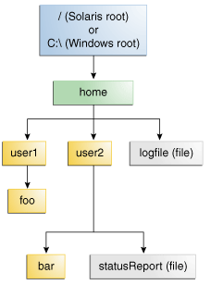
Files and Folders
Absolute or Relative?
An absolute path always
contains the root element and the complete directory list required to locate the file.
A relative path needs to be
combined with another path in
order to access a file.
4

Slide 5
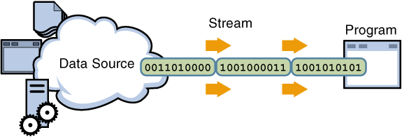
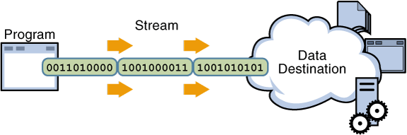
Stream
Streams are ordered sequences of data.
5

Slide 6
Reader and InputStream
InputStream includes the following methods for reading bytes and array of bytes:
int read();
int read(byte cbuf[]);
int read(byte cbuf[], int offset, length);
Reader includes the following methods for reading characters and array of characters:
int read();
int read(char cbuf[]);
int read(char cbuf[], int offset, int length);
Example.
6

Slide 7
Writer and OutputStream
OutputStream provides methods for writing bytes and array of bytes:
int write(int c);
int write(byte cbuf[]);
int write(byte cbuf[], int offset, int length);
Writer provides methods for writing characters and array of characters:
int write(int c);
int write(char cbuf[]);
int write(char cbuf[], int offset, int length);
After Reading or Writing file (byte or character) use close() method to close the stream.
Example.
7

Slide 8
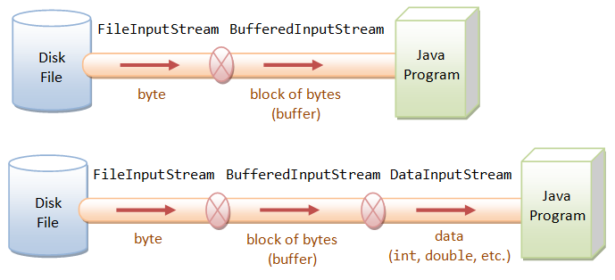
Buffering
Buffered input streams read data from a memory area known as a buffer. The native input API is called only when the buffer is empty.
8

Slide 9
Buffering
Reader and Writer:
BufferedReader in = new BufferedReader(new FileReader(“read.txt"));
BufferedWriter out = new BufferedWriter(new FileWriter(“write.txt"));
To read line by line use method readLine().
String readLine() throws IOException;
The method returns null if the end of the file has been reached.
InputStream and OutputStream :
BufferedInputStream in = new BufferedInputStream(
new FileInputStream("read.txt"));
BufferedOutputStream out = new BufferedOutputStream(
new FileOutputStream("write.txt"));
Example.
9

Slide 10
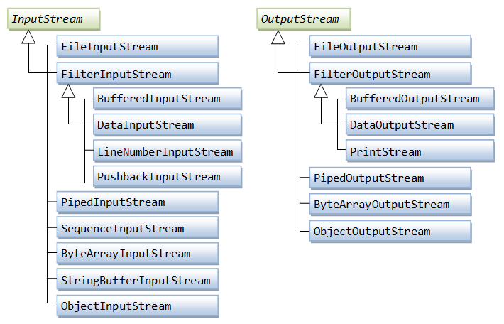
InputStream and OutputStream
10

Slide 11
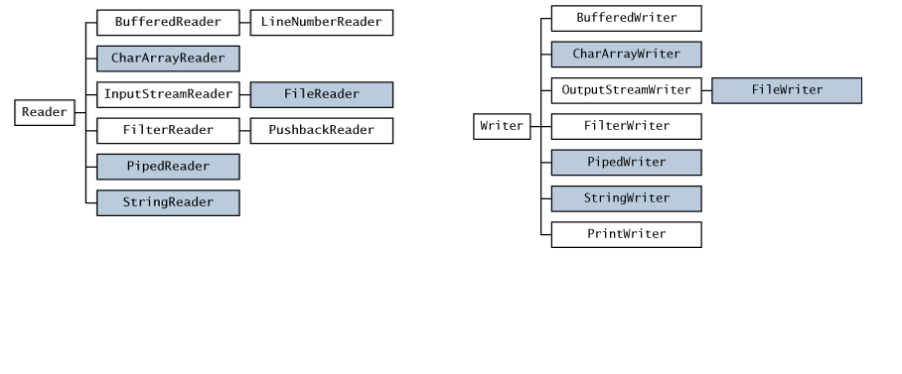
Reader and Writer
11

Slide 12
Serializable
Serialization - is a process of saving object state into byte stream.
Deserialization - is the process of converting the serialized form of an object back into a copy of the object.
It is highly recommended to define static final long serialVersionUID field in serializable classes (used for compatibility checks), otherwise it is computed automatically.
Fields declared as transient or static, are not serialized.
12

Slide 13
Interface Serializable
To serialize an object class must implement the Serializable interface.
public class Car implements Serializable {
……
}
13

Slide 14
Object serialization
The ObjectOutputStream class is used to serialize an Object.
Constructor public ObjectOutputStream(OutputStream out)
Example:
FileOutputStream fos = new FileOutputStream("t.tmp");
ObjectOutputStream oos = new ObjectOutputStream(fos);
oos.writeInt(12345);
oos.writeObject("Today");
oos.writeObject(new Date());
oos.close();
Example.
14

Slide 15
Object deserialization
The ObjectInputStream class is used to deserialize an Object.
Constructor public ObjectInputStream(InputStream in)
Example:
FileInputStream fis = new FileInputStream("t.tmp");
ObjectInputStream ois = new ObjectInputStream(fis);
int i = ois.readInt();
String today = (String) ois.readObject();
Date date = (Date) ois.readObject();
ois.close();
Example.
15

Slide 16
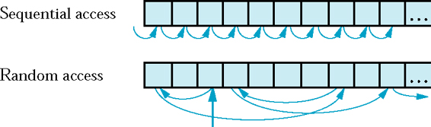
Class RandomAccessFile
Random access files permit nonsequential, or random, access to a file’s contents.
Is used when streams are not suitable, e.g. random access of large binary files.
Both reading and writing is possible(depending on mode).
public void seek(long pos) throws IOException;
Example.
16

Slide 17
Class Scanner
A simple text scanner which can parse primitive types and strings using regular expressions.
A Scanner breaks its input into tokens using a delimiter pattern, which by default matches whitespace. The resulting tokens may then be converted into values of different types using the various next methods.
boolean hasNext();
Scanner useDelimiter(String pattern);
String next();
Scanner skip(Pattern pattern);
After Reading use close() method to close the stream.
Example.
17

Slide 18
Java nio
All data operations are performed on Buffers
There are buffers for all primitive types, like ByteBuffer, LongBuffer, FloatBuffer, etc.
Buffers are allocated using their static methods.
Buffers are internally arrays, which maintain their capacity, limit and position, thus simplifying writing code
Asynchronous I/O:
Java nio provides APIs for asynchronous I/O
All other I/O in java is synchronous(bloking).
18

Slide 19

Questions
19
Notes:
Call a subclass method with superclass reference
Compiler error
Subclass methods are not superclass methods

Slide 20
Thank you.
20
Notes:
Call a subclass method with superclass reference
Compiler error
Subclass methods are not superclass methods

